Slide 1
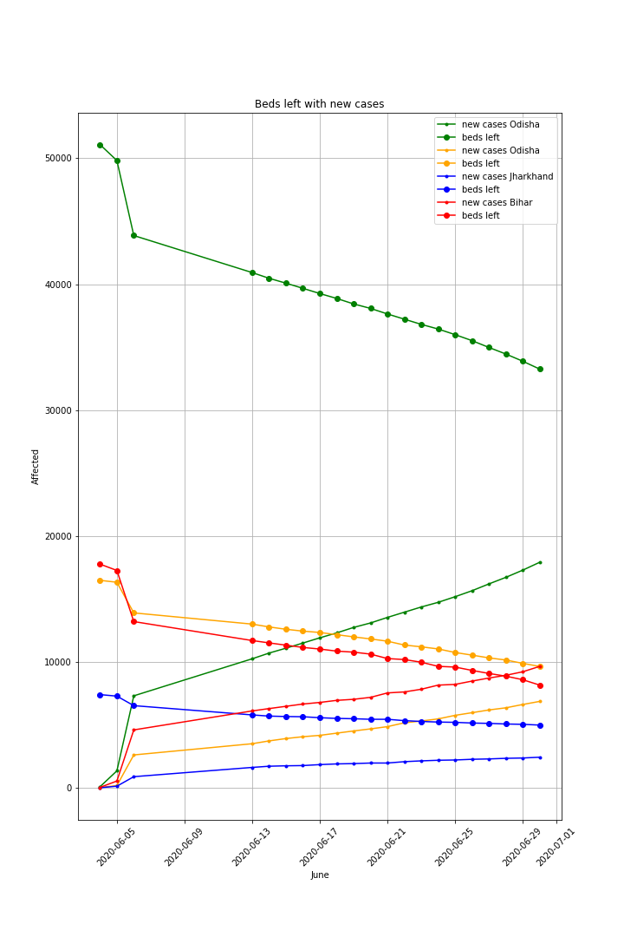
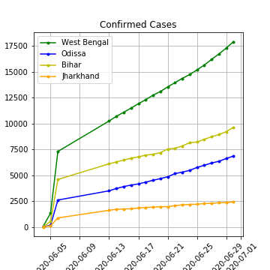
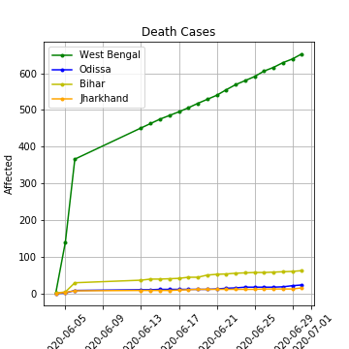
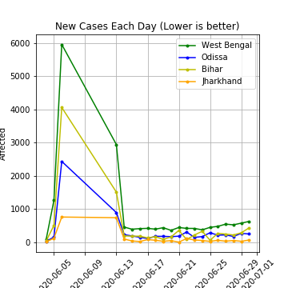
Beds Available According
to Increase Cases
It shows the comparison of beds available on West Bengal along with Bihar, Jharkhand and Orisha.
Through this visualization we can find out if any state needs help from the hospitals of another neighboring states.
If the two line crosses each other ,it means the state is out of public beds.

